Slide 1



HYATT REGENCY GURGAON

Slide 2

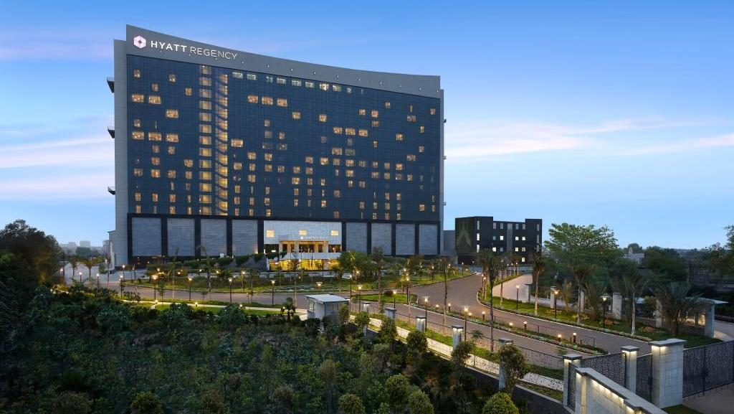
The Largest Convention Hotel in Gurgaon Located in the rapidly expanding business and residential city of Gurgaon in India’s National Capital Region (NCR). Hyatt Regency Gurgaon has the largest meetings and events space and caters to large multi-purpose MICE (meetings, incentives, conferences and exhibitions) from across the country.

Slide 3
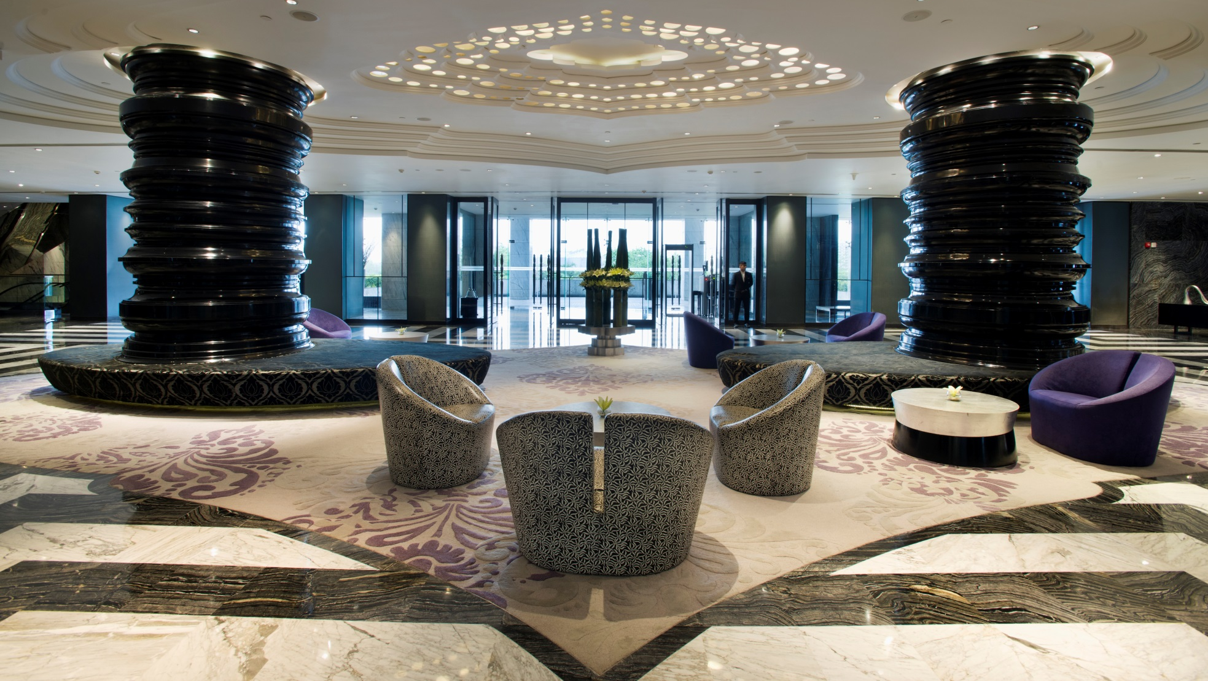
Hotel Lobby - Great place to meet & greet.

Slide 4
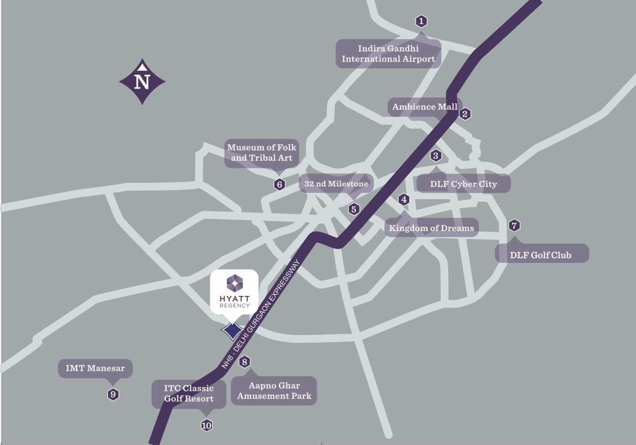
Location
Strategically located off the Delhi-Jaipur National Highway 8, adjacent to the KM 42 Toll Plaza. Hyatt Regency Gurgaon is the ideal hotel for business travellers to Gurgaon
Easy access from the National Highway 8, The hotel is conveniently located within thirty minutes from the Indira Gandhi International Airport and is just fifteen minutes drive from Gurgaon city centre .
Our urban, contemporary hotel offers a 5 star luxury gateway to Gurgaon, dubbed as one of India’s “fastest growing commercial centres”.
Situated in between the commercial hub and industrial zone of Gurgaon, Manesar & Bhiwadi.
The location of the property makes it an ideal base for tourists covering the entire ‘Golden Triangle’ of Delhi, Agra & Jaipur.

Slide 5
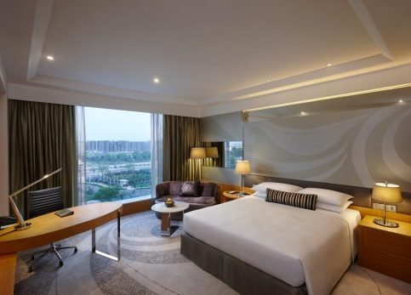
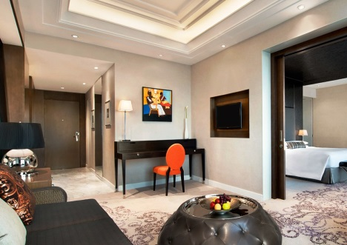
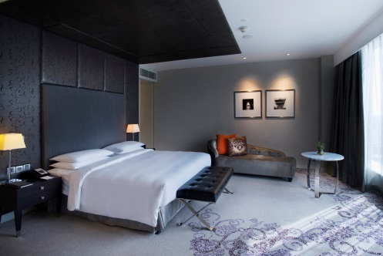
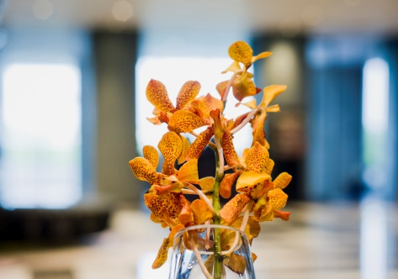
Spacious Rooms. Comfortable Stay.
451 well-appointed, spacious guestrooms (44 sq mts.) including 37 luxurious suites (starting from 88 sq mts.) are thoughtfully designed to contribute to the stylish & comfortable ambience.
Four specially designated Regency Club floors for the club guests include a Regency Club Lounge which offers a complimentary buffet breakfast and evening cocktails. The Regency Club’s other services include private check-in and check-out facilities, limited access to a private boardroom.
Room configuration includes :
174 King Room Standard
165 Twin Room Standard
38 Club King Rooms
37 Club Twin Rooms
35 Regency King Suite
01 Regency Executive Suite
01 Presidential Suite

Slide 6
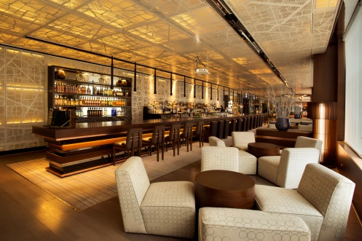
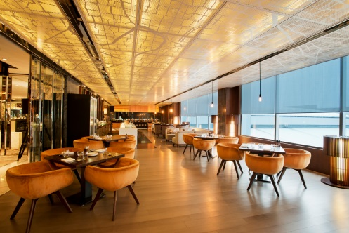
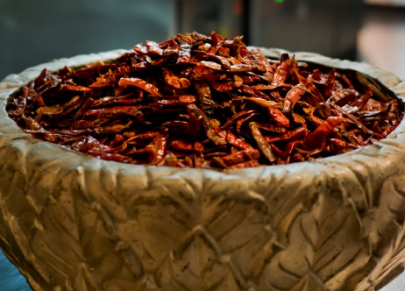
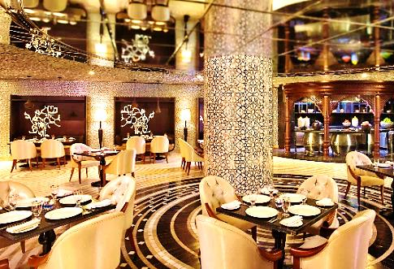
Experience a wide array of authentic Indian, Japanese, Mediterranean, Western & Asian cuisines that take you to an unparalleled gastronomical treat through different restaurants & bars at Hyatt Regency Gurgaon.
Lavana — signature restaurant offering a delectable selection of Awadhi specialties
The Lounge — the ideal venue for a quick breakfast, a casual business meeting cum lunch or early evening snacks and drinks
Kitchen District — interactive kitchens serving Asian, Indian and Western cuisines as well as homemade desserts and ice creams. Awarded “Best South Indian Fine Dining Restaurant” at Times Food guide Awards 2016
The Long Bar — a stylish and intimate bar featuring an eclectic selection of premium sprits, a range of new and old world wines and innovative cocktails created by engaging and skilful bartenders

Slide 7

MEETING &
EVENT
FACILITIES

Slide 8
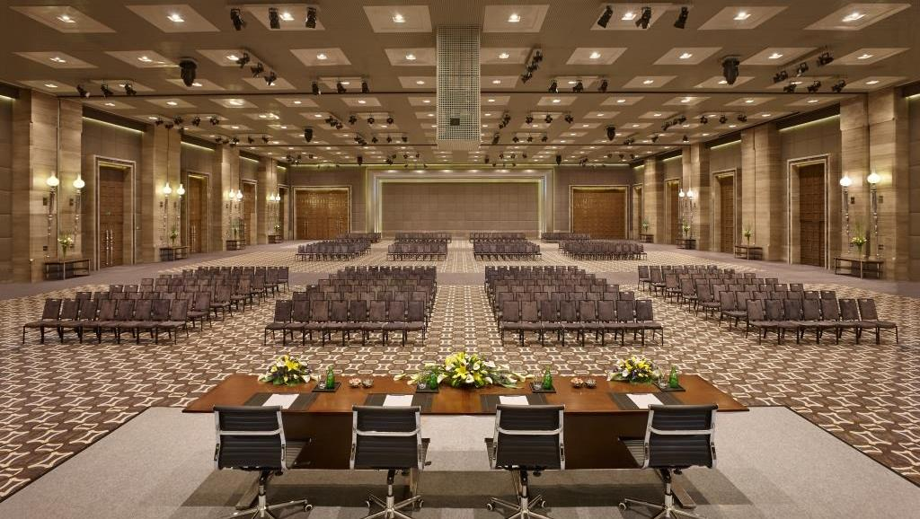
Regency Ballroom - Spread over 20,710 sq. ft. of area, with a majestic ceiling height of 28 ft.

Slide 9

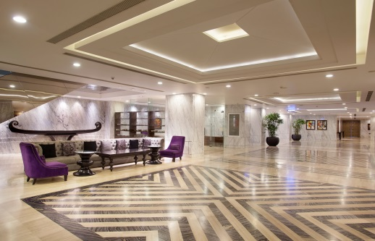
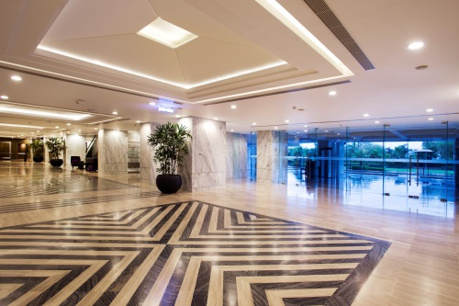
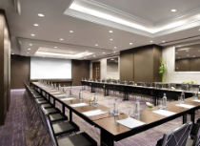
Conferences & Banquets
Largest convention space with more than 3,700 sqm (40,000 sq ft) of meeting event space
The magnificent pillar-less Regency Ballroom has an area of 20,710 sq. ft. and a majestic ceiling height of 28 ft. Built to accommodate up to 3,000 guests, the ballroom features the latest technology, surround sound system and conferencing facilities to provide an unparalleled audio-visual experience.
A total of 15 meeting venues which can accommodate anywhere between 4 - 400people
14,800 sq ft of versatile pre-function areas
Exclusive cargo access and two dedicated separate entrances
To facilitate your event, meeting aids and technical assistance are available, which include an impressive inventory of state-of-the-art equipment for high-speed Internet access and video conferencing
Dedicated Event Planning Team.
Innovative menus with live cooking options
Outdoor lawn for Gala dinners and themed evenings
Ability to provide Out Door Catering for exclusive meetings and events

Slide 10
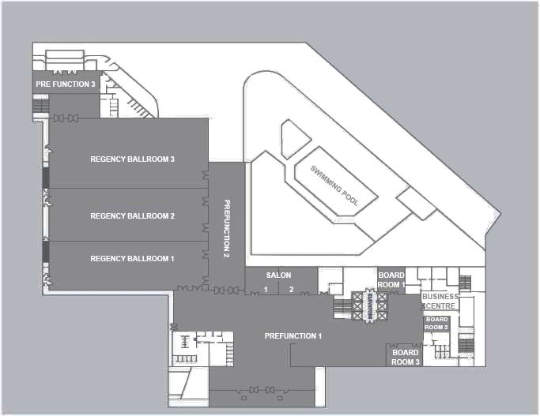
Layout of Conferences & Banquet facility

Slide 11
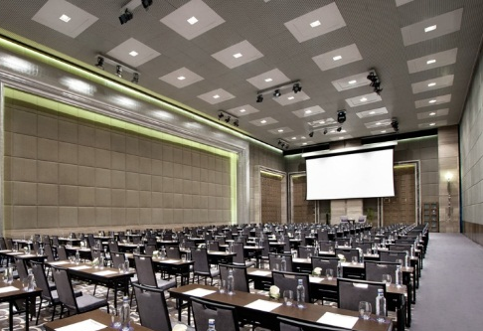
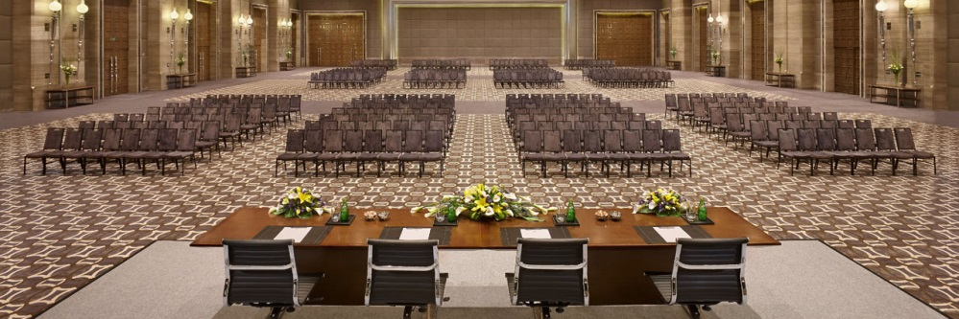
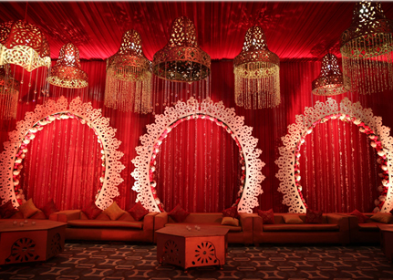
The Regency Ballroom :
20,710 sq feet with a clear ceiling height of 28 feet. It is pillar less and can be divided into 3 sound proof sections. It has two dedicated entrances and three flexible Pre-function areas. With state of the art technology, communication infrastructure and a dedicated cargo entrance, the Ballroom is ideal to host large conferences, weddings, conventions and exhibitions
Pillar-less Regency Ballroom (1,936 sqm/ 20,710 sq ft) which can accommodate up to 3000 guests theatre style with a clear ceiling height of 28 ft. It is also divisible into 3 sound proof sections to cater to smaller events, like weddings, parties etc.
Dedicated Pre-function area
It is the only ballroom in the country to house an in-built Christie projector producing 35,000 lumens (Highest Lumens offered in native HD).
There are 144 inbuilt LED Par Cans and 8 Moving Heads at the Regency Ballroom

Slide 12
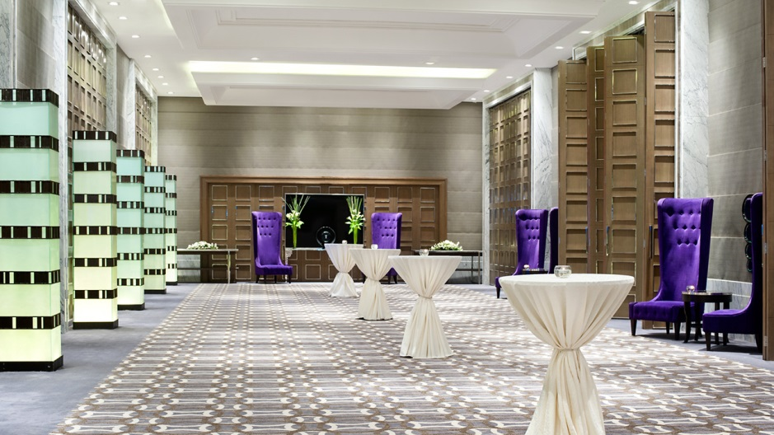
Events Pre-Function Area - The pool side is connected to one of the Ballroom pre-function areas to host gala dinners by the pool.

Slide 13
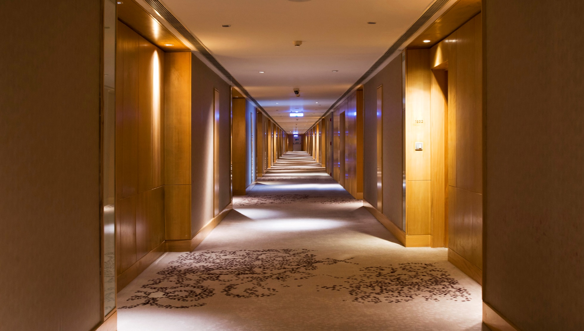

Events Pre-Function Area - Each section of the ballroom has its own pre-function area and separate entrance, in order to maintain the exclusivity of multiple events taking place simultaneously.

Slide 14

Events Pre-Function Area – Dedicated entrance to provide an impactful sense of arrival

Slide 15
How we are specialized to handle your Events
How we are specialized to handle your Events
Medical Conferences/ Associations
Product launch
Exhibition
Incentive Group/ Annual Meet
Social functions

Slide 16
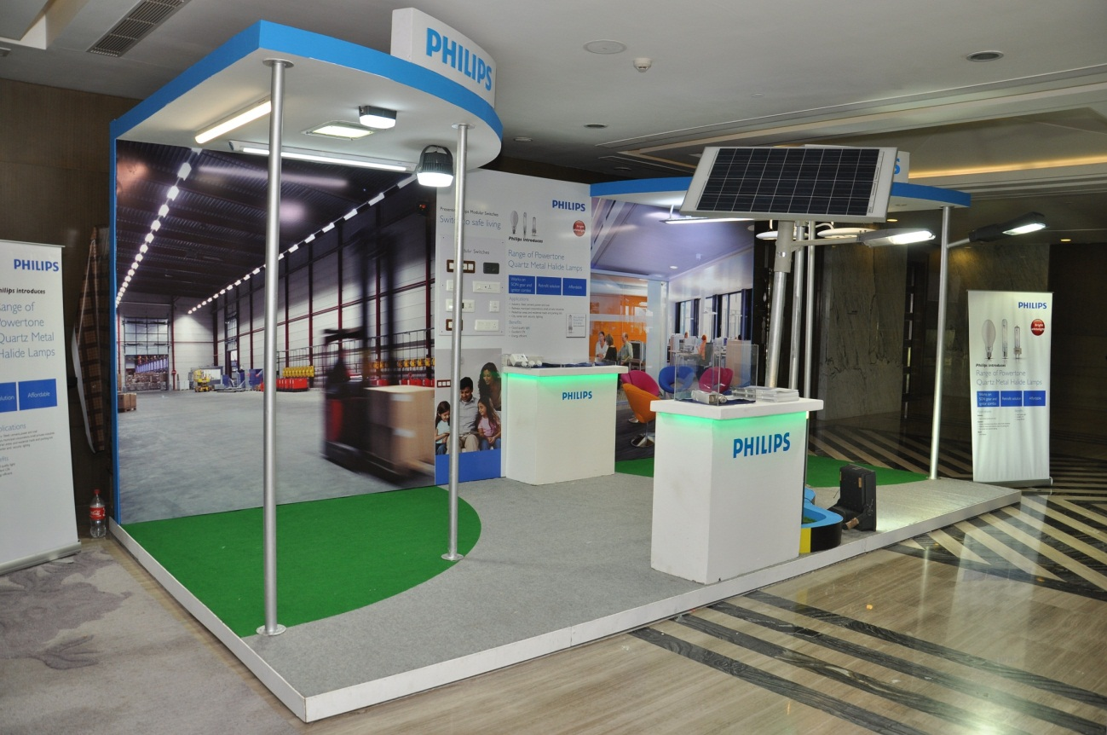
Exhibition
Exhibition

Slide 17
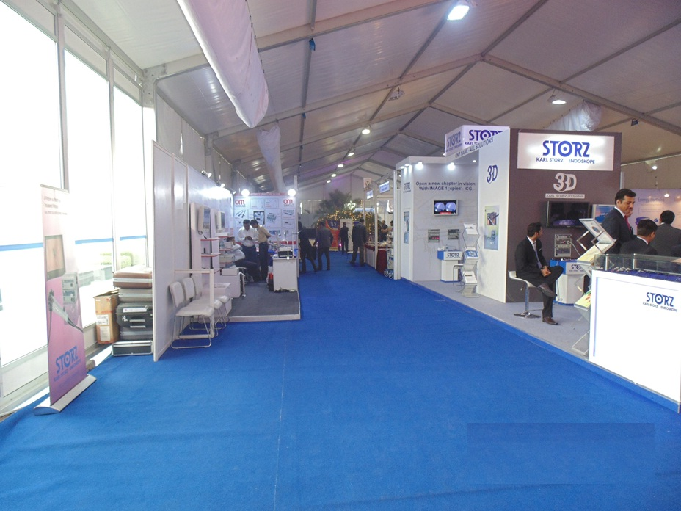
Exhibition
Exhibition

Slide 18
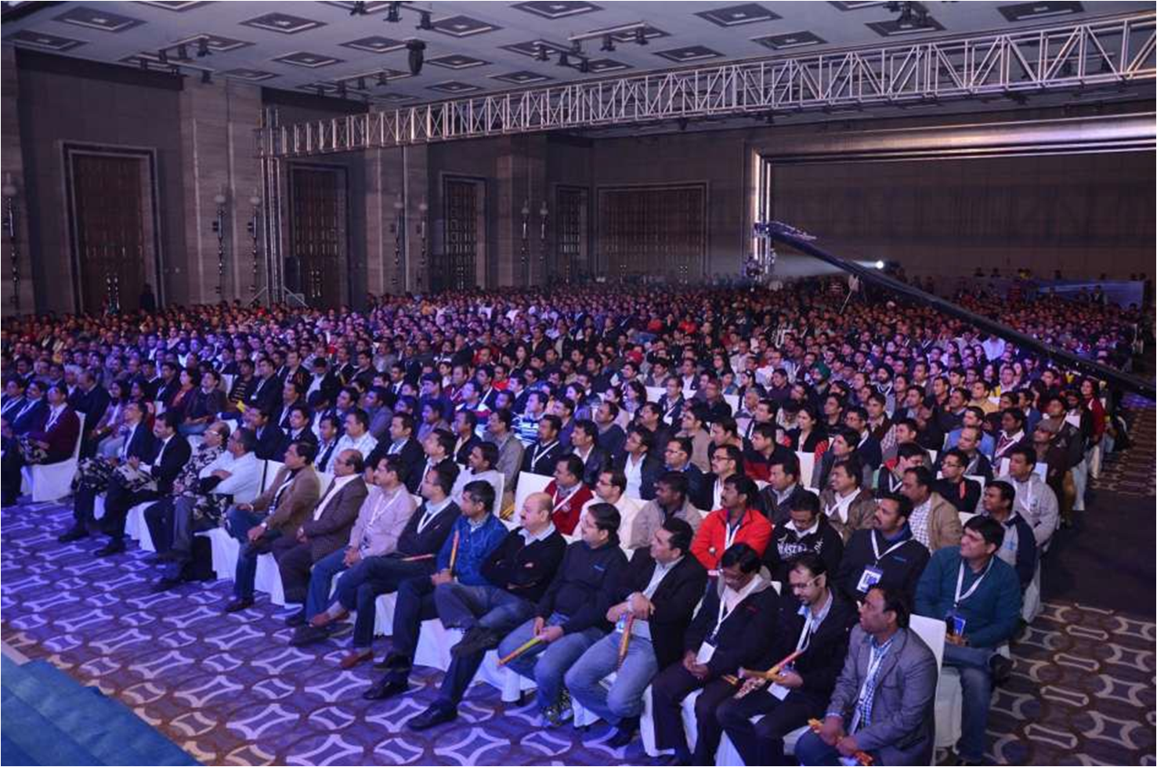
Exhibition
Conferences

Slide 19
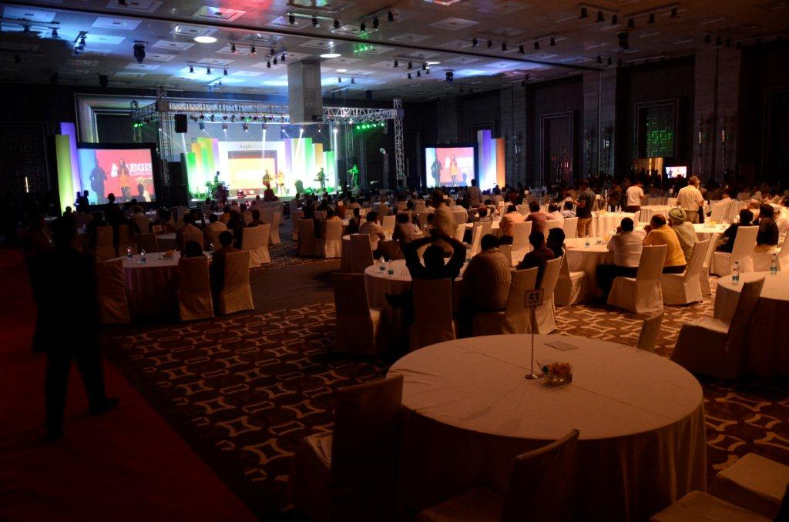
Exhibition
Conferences

Slide 20
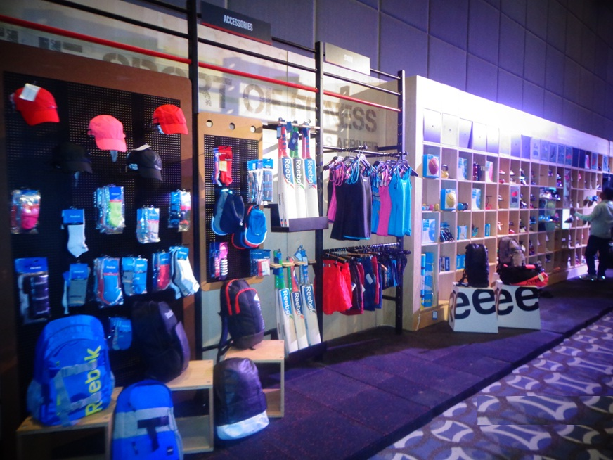
Product Launch

Slide 21
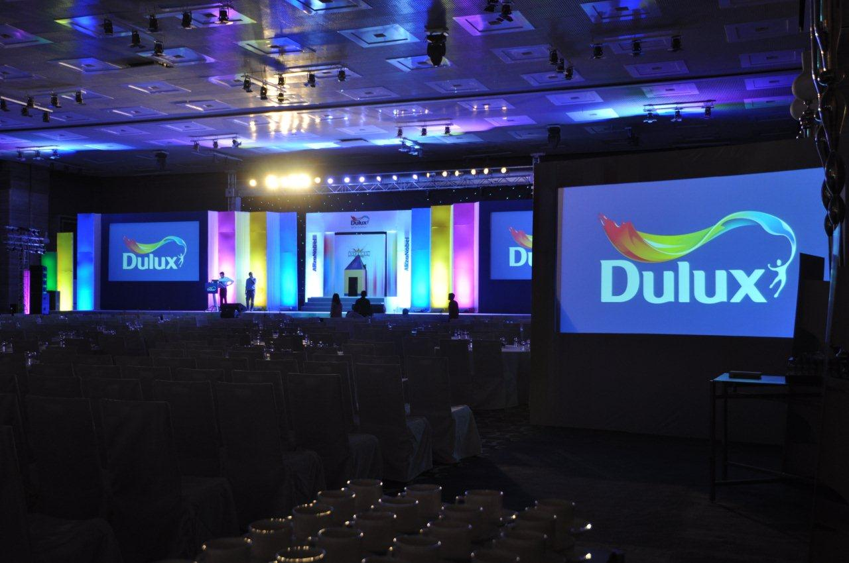
Product Launch
Product Launch

Slide 22
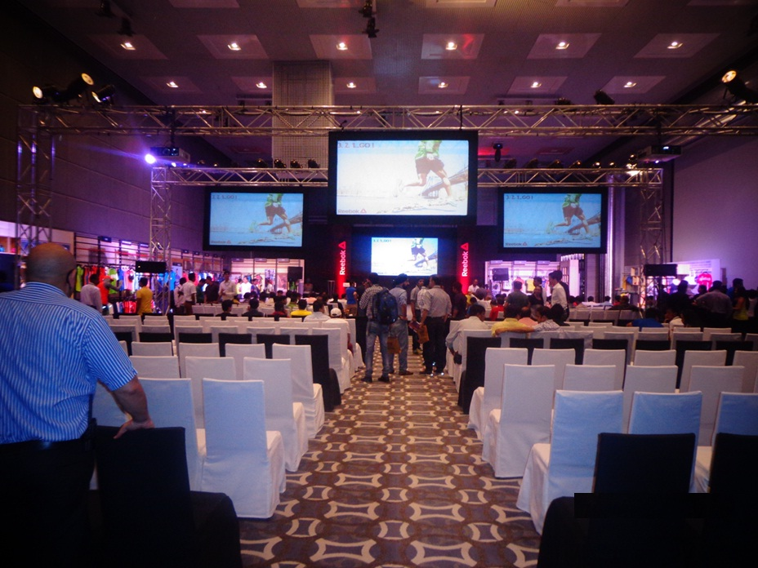
Product Launch

Slide 23

Spiritual Events

Slide 24
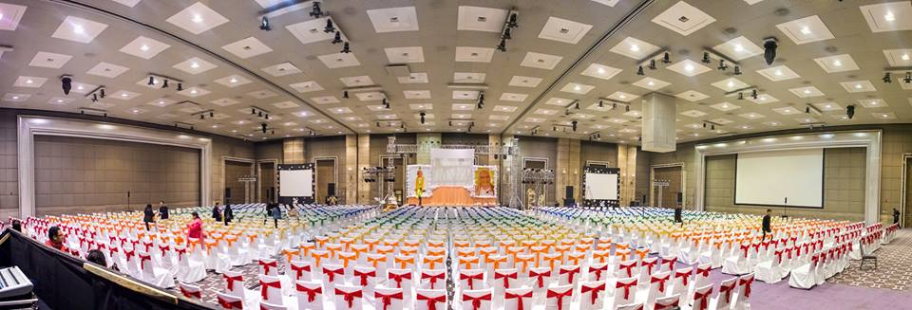
Spiritual Events

Slide 25
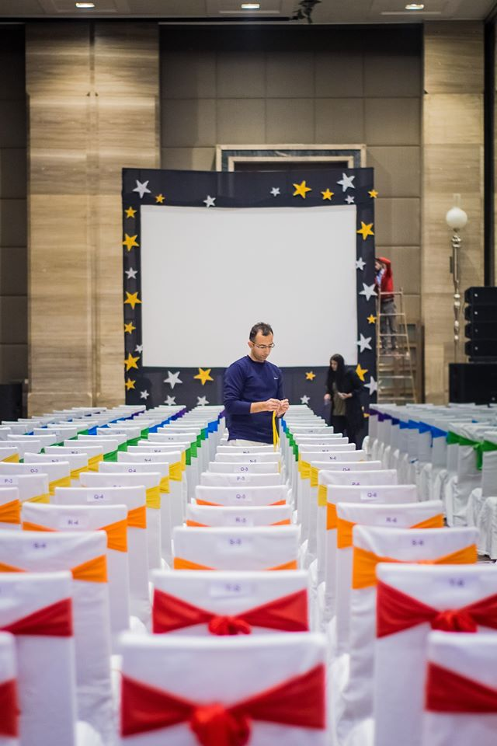
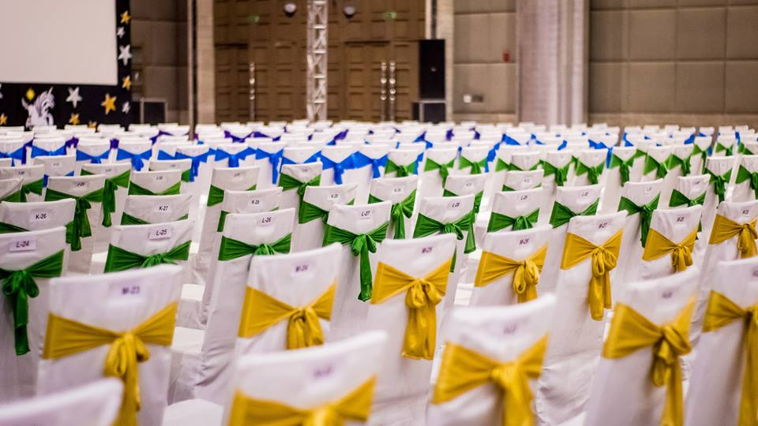
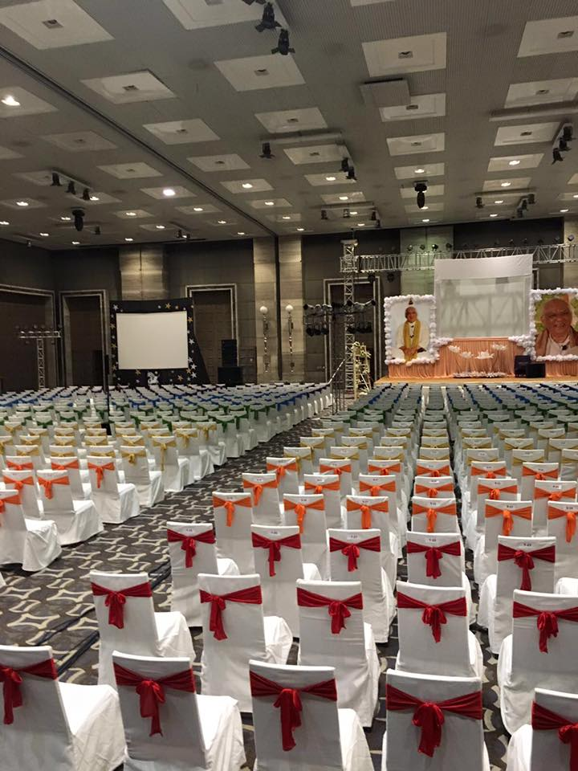
Spiritual Events

Slide 26
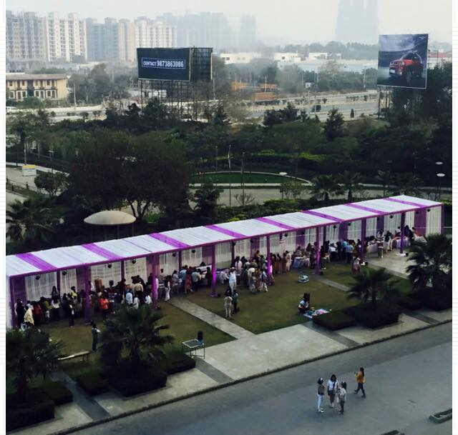

Slide 27
Medical Conferences

Slide 28
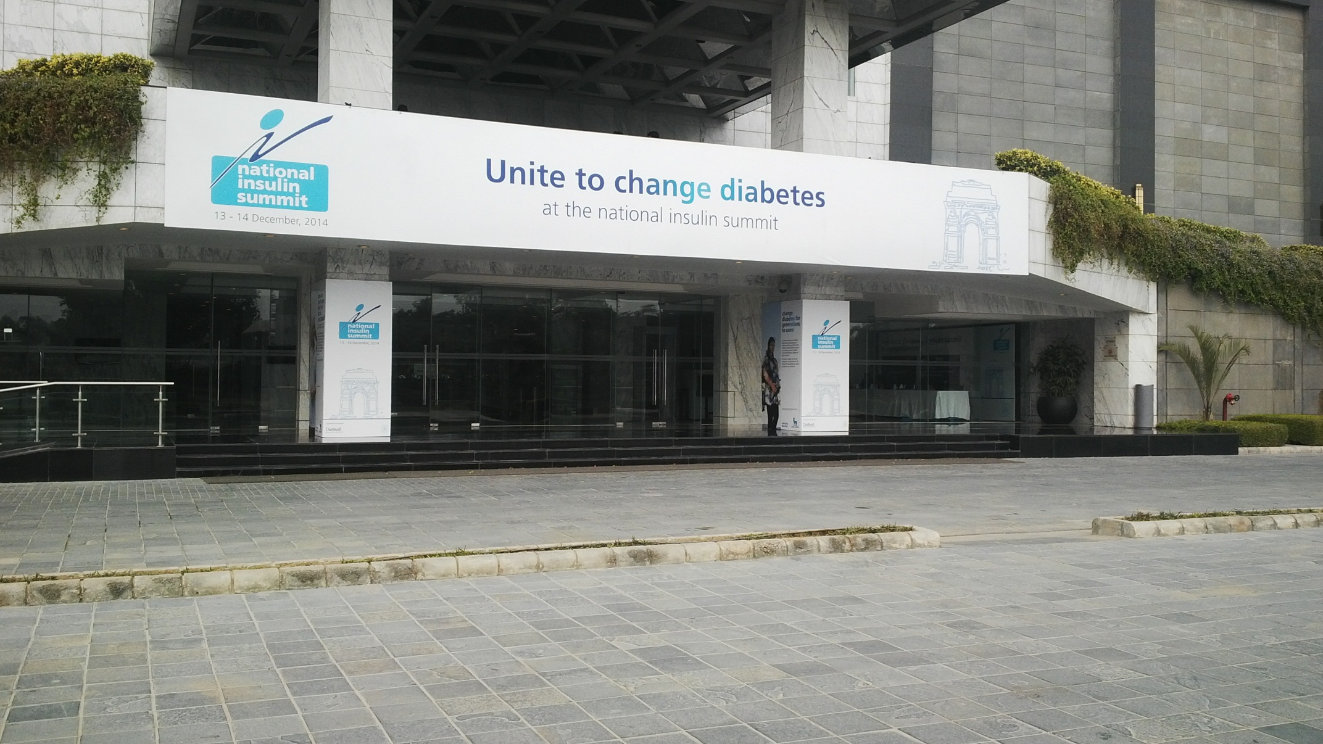

Slide 29
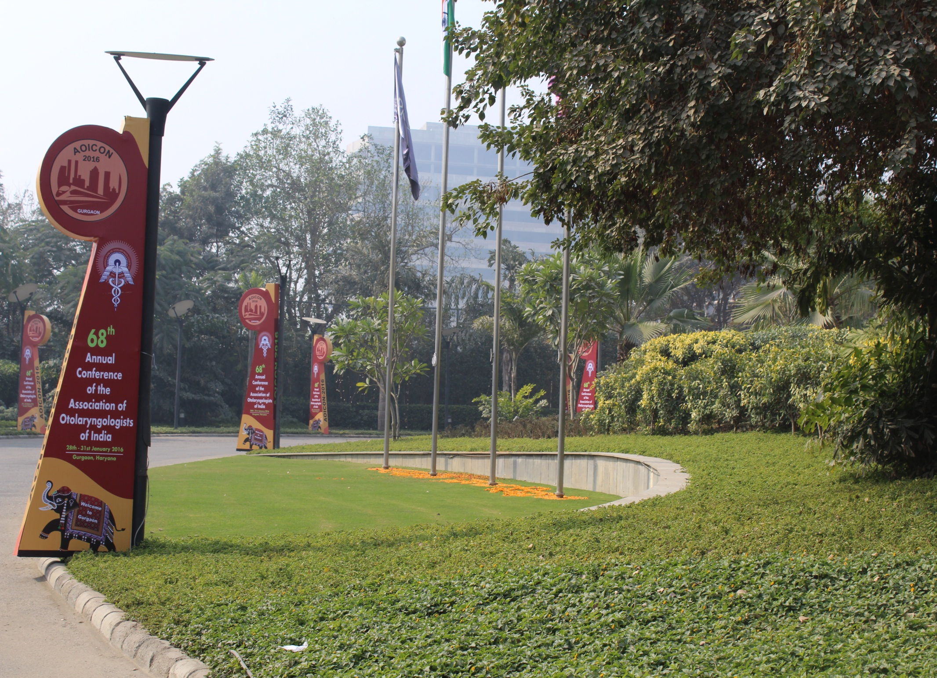

Slide 30
Stalls Layout during Medical conferences

Slide 31


Thank you

